Slide 1
Lecture 2: Filters
Tom Jhou

Slide 2
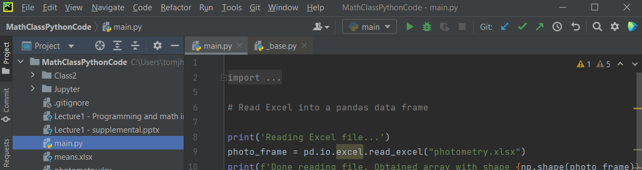
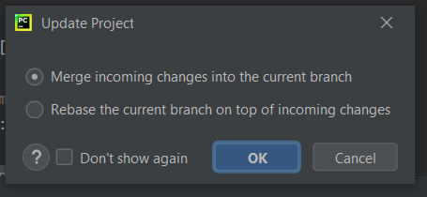
A few things before we start:
Update project using PyCharm’s blue arrow:
Accept default, click OK

Slide 3

Launch Anaconda, then Jupyter:

Slide 4
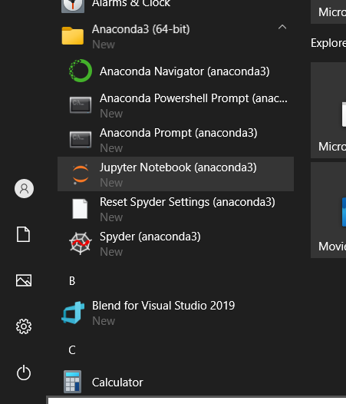
If it gets stuck, launch from start menu …:

Slide 5
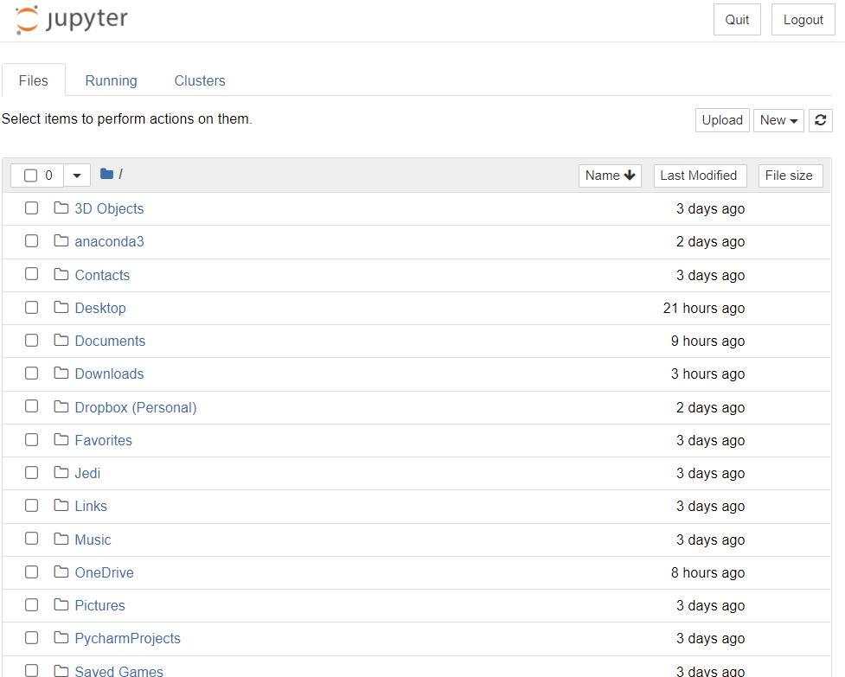
You should see your home folder:

Slide 6
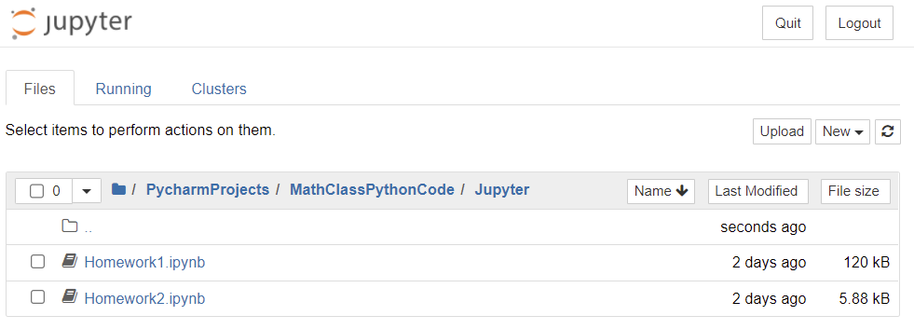
Navigate to Homework1.ipynb:

Slide 7
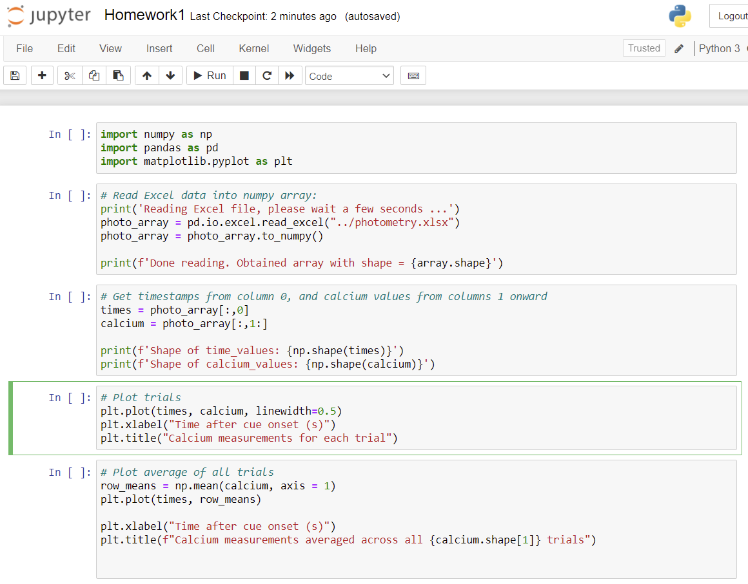

Slide 8
Now back to our regularly scheduled programming…

Slide 9


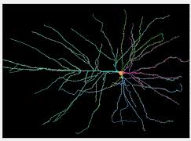
Filters enhance signals, reduce noise:
Found everywhere:
Sound/video processing: microphones, cameras, medical equipment, etc.
Analysis software
Biological systems (visual and auditory cortex)

Slide 10
How do you define “noise”?
Depends on your goal.
“Noise” in one experiment may be “signal” in another.

Slide 11
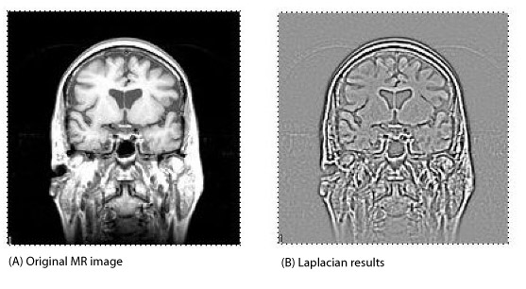

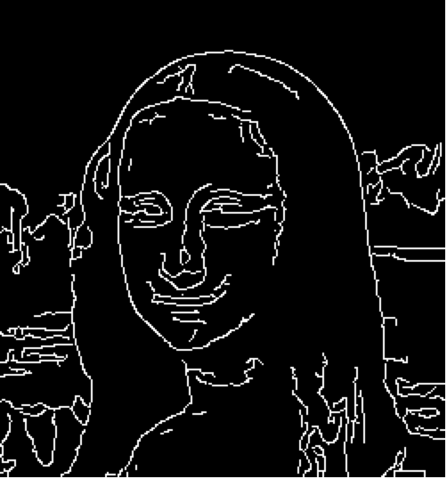
Imaging examples:
“Edge detection” filter
Notes:
This works like a charm. Before filtering, the background noise ranges over several millivolts, while spikes are only about 300 microvolts.
After filtering, background noise is about 100 microvolts, while spikes are still about 300 microvolts.
We removed a lot of stuff, and drastically reduced the background noise while spikes are almost the same height as before.

Slide 12
Example: neural spike detection:
Notes:
This works like a charm. Before filtering, the background noise ranges over several millivolts, while spikes are only about 300 microvolts.
After filtering, background noise is about 100 microvolts, while spikes are still about 300 microvolts.
We removed a lot of stuff, and drastically reduced the background noise while spikes are almost the same height as before.

Slide 13
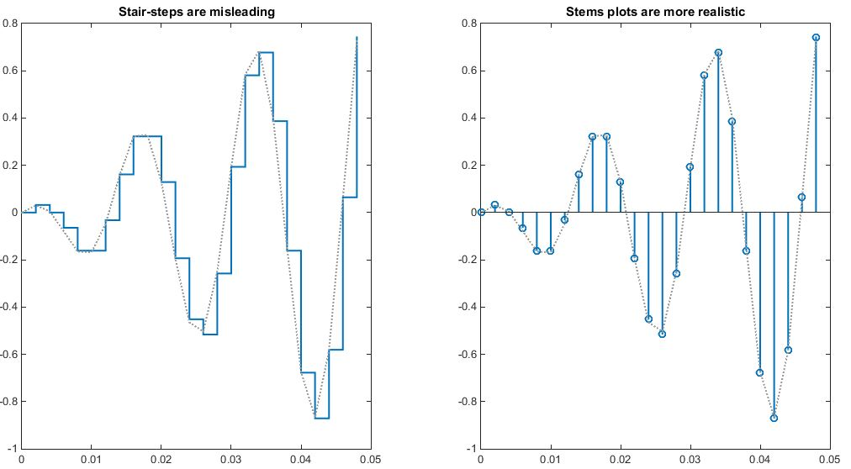
“Sampling” turns real-world signals into lists of numbers that Python/MATLAB can work with
“Stem” plot
Notes:
This works like a charm. Before filtering, the background noise ranges over several millivolts, while spikes are only about 300 microvolts.
After filtering, background noise is about 100 microvolts, while spikes are still about 300 microvolts.
We removed a lot of stuff, and drastically reduced the background noise while spikes are almost the same height as before.

Slide 14
“staircase” plot
Notes:
This works like a charm. Before filtering, the background noise ranges over several millivolts, while spikes are only about 300 microvolts.
After filtering, background noise is about 100 microvolts, while spikes are still about 300 microvolts.
We removed a lot of stuff, and drastically reduced the background noise while spikes are almost the same height as before.

Slide 15
If sample rate is high, they blend together into a continuous line. But signal is still ultimately a list of numbers.
Notes:
There are fast wiggles and slow wiggles. The background noise tends to have lots of slow wiggles, the spikes tend to have lots of fast wiggles. We can use this to our advantage.
There are 20,000 points shown. The sampling rate is 31.25kHz, so this is about 2/3 of a second in the top part, and 1/8 second in the bottom part.

Slide 16
Perform “spectral analysis” of spikes vs noise
Background “noise”
Spikes
Notes:
“Noise” is in quotation marks because it actually is a brain signal. It comes from neurons that are too far away from recording wire to be resolved independently.

Slide 17
Spectral analysis is what a prism does: it “unmixes” colors:
Low frequencies
High frequencies
Notes:
The function is easy to call, but you have to pay careful attention to the details of the frequencies that come out.

Slide 18
Noise is predominantly low-frequency. If we remove it, spikes will “stick out” more.
Background “noise”
Spikes
Notes:
“Noise” is in quotation marks because it actually is a brain signal. It comes from neurons that are too far away from recording wire to be resolved independently.

Slide 19
How to do frequency analysis? FFT = “Fast Fourier Transform”
import numpy as np
y = np.fft.fft(waveform);
waveform = list of voltage samples at regular time intervals
y = list of amplitudes at regular frequency intervals
Notes:
The function is easy to call, but you have to pay careful attention to the details of the frequencies that come out.

Slide 20

FFT of sine wave …
5 Hz sine wave,
Sampled at 100 Hz
FFT of above
Peak at 5 Hz
Ignore the right half of FFT for now.
Notes:
The function is easy to call, but you have to pay careful attention to the details of the frequencies that come out.

Slide 21
FFT of square wave:
5 Hz square wave,
Sampled at 100 Hz
waveform
Peaks at 5, 15, 25, 35, 45 Hz
FFT
Notes:
The function is easy to call, but you have to pay careful attention to the details of the frequencies that come out.

Slide 22
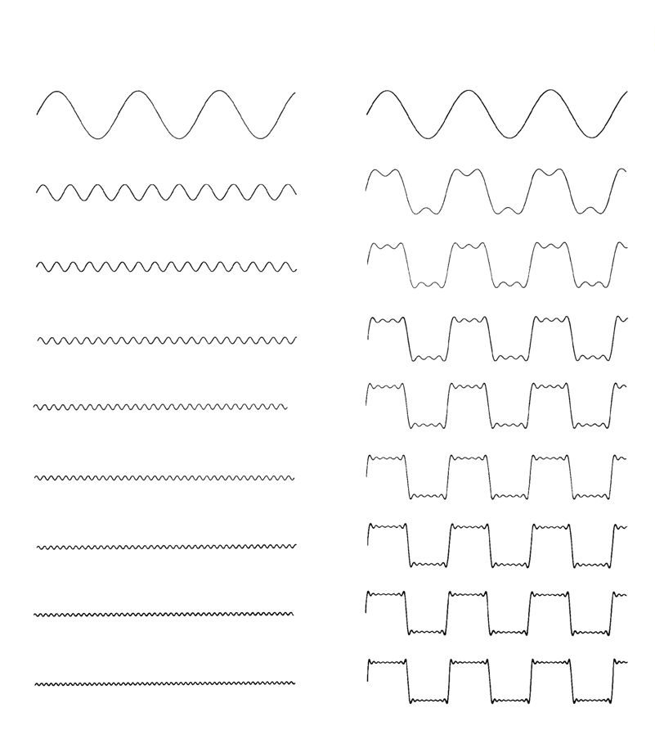
Basically, a square wave is really a combination of sinusoidal harmonics:
Sine waves, odd harmonics only
Cumulative sum:
5 Hz
15 Hz
25 Hz
35 Hz
45 Hz
etc…
Notes:
Note that the sine wave amplitudes are exactly inversely proportional to the frequency, i.e. they get smaller as frequency goes up. The “discrepancy” between sinusoidal sum and “true” square wave gets smaller and smaller as well.

Slide 23
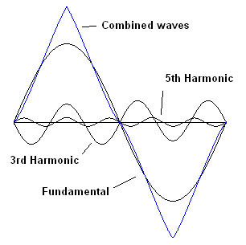
By adjusting amplitudes, can make triangle instead of square wave
Negative amplitude for harmonics 3, 7, 11, etc
Square wave: Harmonic amplitudes = 1/n, n = 1, 3, 5, …
Triangle wave: nth harmonic amplitude = (-1)^{n}/n², n = 1, 3, 5, …
Notes:
Note that the sine wave amplitudes are exactly inversely proportional to the frequency, i.e. they get smaller as frequency goes up. The “discrepancy” between sinusoidal sum and “true” square wave gets smaller and smaller as well.

Slide 24
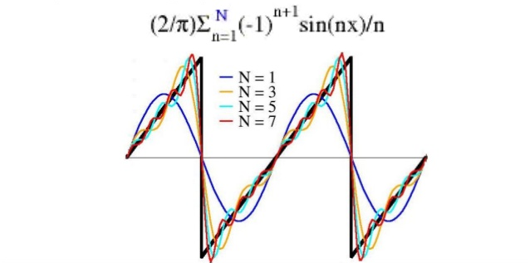
Adding even harmonics gives sawtooth wave:
Notes:
Note that the sine wave amplitudes are exactly inversely proportional to the frequency, i.e. they get smaller as frequency goes up. The “discrepancy” between sinusoidal sum and “true” square wave gets smaller and smaller as well.

Slide 25
By modifying phase and amplitude, can build any waveform
https://www.youtube.com/watch?v=ds0cmAV-Yek
Notes:
Destin doesn’t explain one very critical item, which is that the rotational speeds of the various circles are all FIXED INTEGER MULTIPLES of each other. The first circle rotates at some constant speed. The second circle rotates at twice that speed, the third circle rotates at 3 times the speed, and so on. The shape is entirely defined by the diameters (amplitudes) of the circles.

Slide 26
FFT of neural recording
EEG
Spikes
Notes:
There are fast wiggles and slow wiggles. The background noise tends to have lots of slow wiggles, the spikes tend to have lots of fast wiggles. We can use this to our advantage.
There are 20,000 points shown. The sampling rate is 31.25kHz, so this is about 2/3 of a second in the top part, and 1/8 second in the bottom part.

Slide 27
Noise has a lot of low frequencies (slow wiggles). Can remove them with “high-pass” filter.
Background
Spikes
Removing low frequencies will get rid of a LOT of background, but much less signal

Slide 28
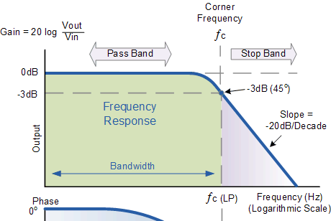
Filters are never perfect. There is “transition” from “pass” to “stop” bands
100% pass
70.7% pass
Output in the stop band is lower, but not zero.
Frequencies just above the cutoff frequency are not attenuated as effectively as those much further above.

Slide 29
Note the “decibel” notation:
dB = 20 * log_10.
Why 20, and not 10?
Because power = amplitude², so 10x amplitude increase gives 100x power increase.

Slide 30
3dB is the “half power” point:
This is where amplitude is 70.7% of max.
20 * log(0.707) = -3.01
Power = amplitude², and (0.707)² = 0.5

Slide 31
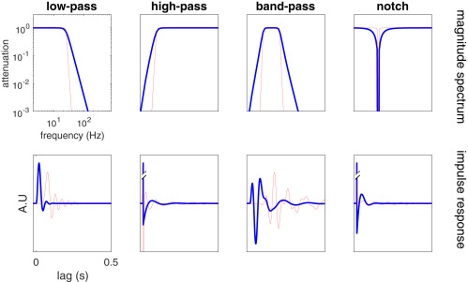
Other standard filter types
Any shape is possible, including multiple pass bands, or arbitrary shapes.
“Roll-off” rate varies with filter type - can be shallow or steep.

Slide 32
Why did I plot log axes? To avoid smushing low frequencies together:
Log axes
Linear axes
EEG
EEG
Spikes
Spikes
Notes:
“Noise” is in quotation marks because it actually is a brain signal. It comes from neurons that are too far away from recording wire to be resolved independently.

Slide 33
Absolute vs relative change
Log axes show relative change
Linear axes show absolute change
10-fold
range
10-fold
range
10-fold
range
400Hz
range
400Hz
range
400Hz
range
400Hz
range
Notes:
“Noise” is in quotation marks because it actually is a brain signal. It comes from neurons that are too far away from recording wire to be resolved independently.

Slide 34
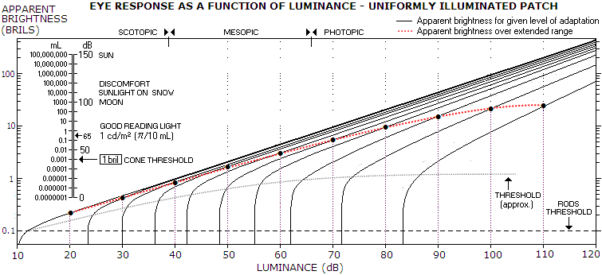
Human perception often logarithmic: Weber’s law
Notes:
“Noise” is in quotation marks because it actually is a brain signal. It comes from neurons that are too far away from recording wire to be resolved independently.

Slide 35
Python code:
kernel = signal.firwin(n, cutoff_frequency*2/sampleRate, pass_zero = False)
output = np.convolve(wave, kernel);
Notes:
This works like a charm. Before filtering, the background noise ranges over several millivolts, while spikes are only about 300 microvolts.
After filtering, background noise is about 100 microvolts, while spikes are still about 300 microvolts.
We removed a lot of stuff, and drastically reduced the background noise while spikes are almost the same height as before.

Slide 36
Voltage histograms
Before filtering
Background
Spikes
Voltage (mV)
Notes:
These are histograms of the voltage ranges. Before filtering, background and spikes range over several millivolts, and overlap.
After filtering, spike peaks are separable from background voltages. We can draw a somewhat arbitrary vertical threshold (blue dotted line) that “detects” most of the spikes while “rejecting” most of the background.

Slide 37
Voltage histograms
After filtering
Background
Detection threshold
Spike peaks
True positives
Voltage (mV)
False positives
Notes:
These are histograms of the voltage ranges. Before filtering, background and spikes range over several millivolts, and overlap.
After filtering, spike peaks are separable from background voltages. We can draw a somewhat arbitrary vertical threshold (blue dotted line) that “detects” most of the spikes while “rejecting” most of the background.

Slide 38
Let’s look at a noisier example:
More selective
(Fewer false positives,
but also more false negatives)
More permissive
Fewer false negatives,
but also more false pos.)
Spikes
Background
True negatives
False negatives
Detection threshold
Voltage (mV)
Notes:
These are histograms of the voltage ranges. Before filtering, background and spikes range over several millivolts, and overlap.
After filtering, spike peaks are separable from background voltages. We can draw a somewhat arbitrary vertical threshold (blue dotted line) that “detects” most of the spikes while “rejecting” most of the background.

Slide 39
“Receiver operator characteristic” (ROC) expresses tradeoff
More selective
(Fewer false positives,
but also more false negatives)
More permissive
Fewer false negatives,
but also more false pos.)
More permissive
Spikes
Background
More selective
Detection threshold
True positives
Voltage (mV)
False positives
Notes:
These are histograms of the voltage ranges. Before filtering, background and spikes range over several millivolts, and overlap.
After filtering, spike peaks are separable from background voltages. We can draw a somewhat arbitrary vertical threshold (blue dotted line) that “detects” most of the spikes while “rejecting” most of the background.

Slide 40
“Receiver operator characteristic” (ROC) expresses tradeoff
More selective
(Fewer false positives,
but also more false negatives)
More permissive
Fewer false negatives,
but also more false pos.)
More permissive
Detection threshold
Spikes
Background
More selective
True positives
Voltage (mV)
False positives
Notes:
These are histograms of the voltage ranges. Before filtering, background and spikes range over several millivolts, and overlap.
After filtering, spike peaks are separable from background voltages. We can draw a somewhat arbitrary vertical threshold (blue dotted line) that “detects” most of the spikes while “rejecting” most of the background.

Slide 41
Filtering greatly improved detection, but still short of perfection
Perfect classification:
Detect 100% of signal, 0% of background.
Can’t get here with this dataset.
More permissive
After filtering
Before filtering
y=x, random classification
More selective
Detecting ~25% of spikes, and ~5% of noise.
Highest signal/noise ratio (5:1).
p = 0.05 (publication standard)
Notes:
These are histograms of the voltage ranges. Before filtering, background and spikes range over several millivolts, and overlap.
After filtering, spike peaks are separable from background voltages. We can draw a somewhat arbitrary vertical threshold (blue dotted line) that “detects” most of the spikes while “rejecting” most of the background.

Slide 42
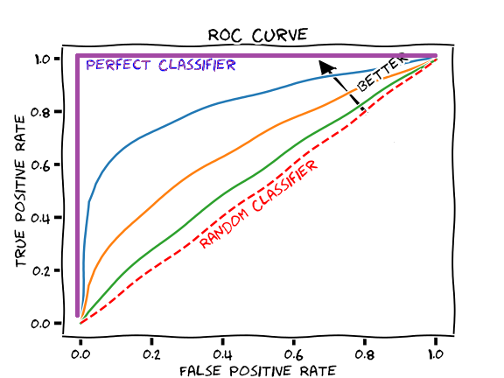
Filtering is big help, but not magic. Often you need a better experiment (better method, or move probe closer to neurons)

Slide 43
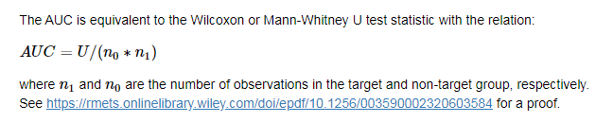
Area under curve (AUC) is proportional to Mann-Whitney “U”
Notes:
These are histograms of the voltage ranges. Before filtering, background and spikes range over several millivolts, and overlap.
After filtering, spike peaks are separable from background voltages. We can draw a somewhat arbitrary vertical threshold (blue dotted line) that “detects” most of the spikes while “rejecting” most of the background.

Slide 44
Python code:
kernel = scipy.signal.firwin(n, cutoff_frequency*2/sampleRate, pass_zero=False)
output = np.conv(input_signal, kernel);

Slide 45
“firwin” function:
kernel = scipy.signal.firwin(n, cutoff_frequency*2/sampleRate, pass_zero=False)
n is filter “order”
cutoff_frequency is half-power frequency (transition from pass to stop bands)

Slide 46
pass_zero argument specifies low vs high-pass behavior
kernel = scipy.signal.firwin(n, cutoff_frequency*2/sampleRate, pass_zero=False)
pass_zero=True
pass_zero=False
0 Hz
0 Hz

Slide 47
“convolve” function does the filtering:
kernel = fir1(n, cutoff_frequency*2/sampleRate, pass_zero=False)
output = np.convolve(input_signal, kernel)
kernel is also called “impulse function”
“convolving” input with kernel produces filtered output.

Slide 48
Higher filter order n gives sharper transition from pass to reject
Reject band
Pass band
N=2
N=5
N=10
N=20
N=100

Slide 49
Low-pass filter
N=2
N=5
N=100

Slide 50
But: high order filters produce delays and other distortions
After
filter
Before
filter
Output is time-delayed (easy to compensate).
Biphasic waveform might become triphasic (NOT easy to correct)
High-order filters distort more than low order
High-pass filters distort more than low-pass.
Notes:
The original spike (brown) is shifted in time and is now triphasic instead of biphasic. Actually, it is almost quadruphasic, as there is a slight backlash to the initial AHP.
The time shift is easy to fix – just subtract. The distortion is much harder to fix. Theoretically you can run it back through a lowpass filter, but that brings back some of the noise you got rid of.
Distortion may or may not be a problem. This depends on the question you are asking. If you just want to know firing rate and spike latency, you don’t have to worry.

Slide 51
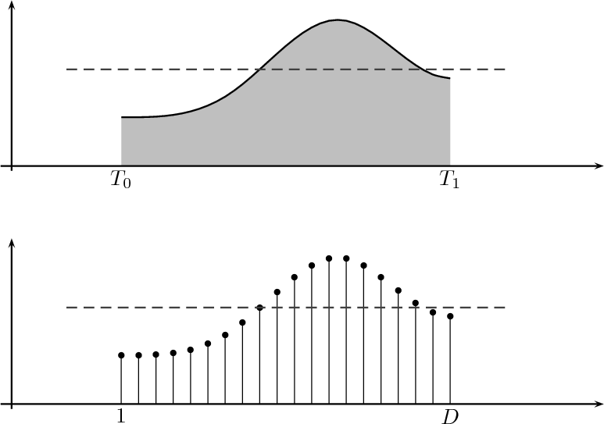
Another distortion:
“Sample rate” is finite. Some information always lost
time
time

Slide 52
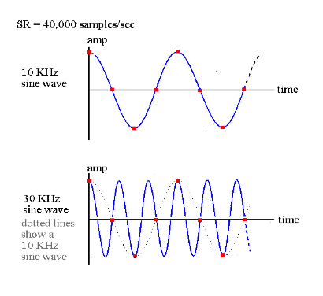
“Aliasing” occurs at low sample rates
Sine wave = 10kHz.
Sample rate = 40kHz
GOOD!
Sine wave = 30kHz.
Sample rate = 40kHz
BAD!
Notes:
Note that the 30kHz wave looks exactly like the 10kHz wave when sampled at 40kHz. This is the “aliasing”, where one wave looks like another.

Slide 53
Aliasing
At 40kHz sample rate,
10kHz, 30kHz look same

Slide 54
Aliasing
19kHz, 21kHz look same
5kHz, 35kHz look same
1kHz, 39kHz look same
Max unambiguously detected frequency is 20 kHz.
“Nyquist” frequency

Slide 55
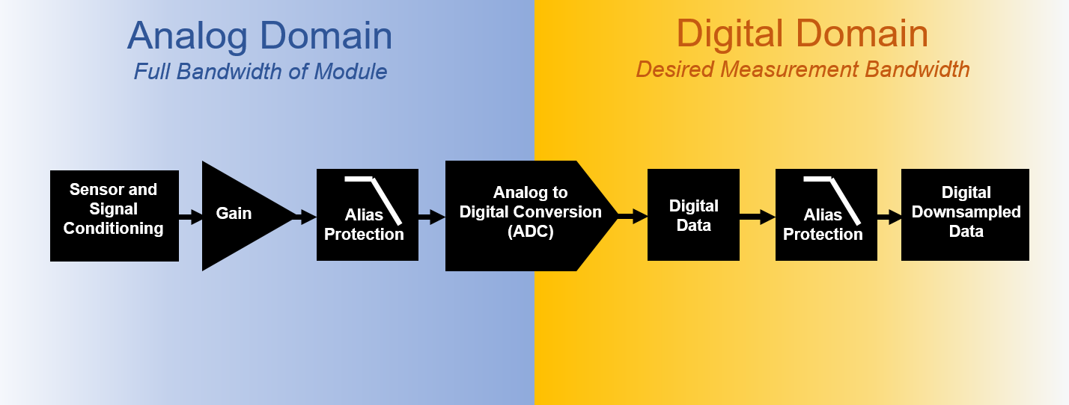
Typically need analog filter before digital sampling
Low-pass ANALOG filter
https://community.sw.siemens.com/s/article/data-acquisition-anti-aliasing-filters

Slide 56
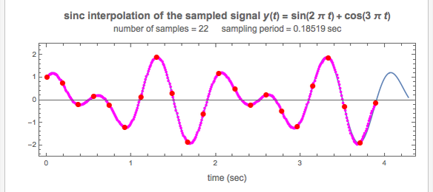
If frequencies < Nyquist, original wave can be interpolated perfectly from samples (via sinc function)
Blue = original signal. Red dots = sampled.
Magenta = interpolated from samples using sinc function.
https://demonstrations.wolfram.com/SincInterpolationForSignalReconstruction/

Slide 57
Homework, due in 1 week
Update the github repository. You should see a folder called Class2, and a Python file called Homework2.py
Task 1: write code to remove the noise and identify the underlying musical piece.
Task 2: Plot Fourier transforms of wave before and after filtering.

Slide 58
The end. Ignore any slides after this one.

Slide 59
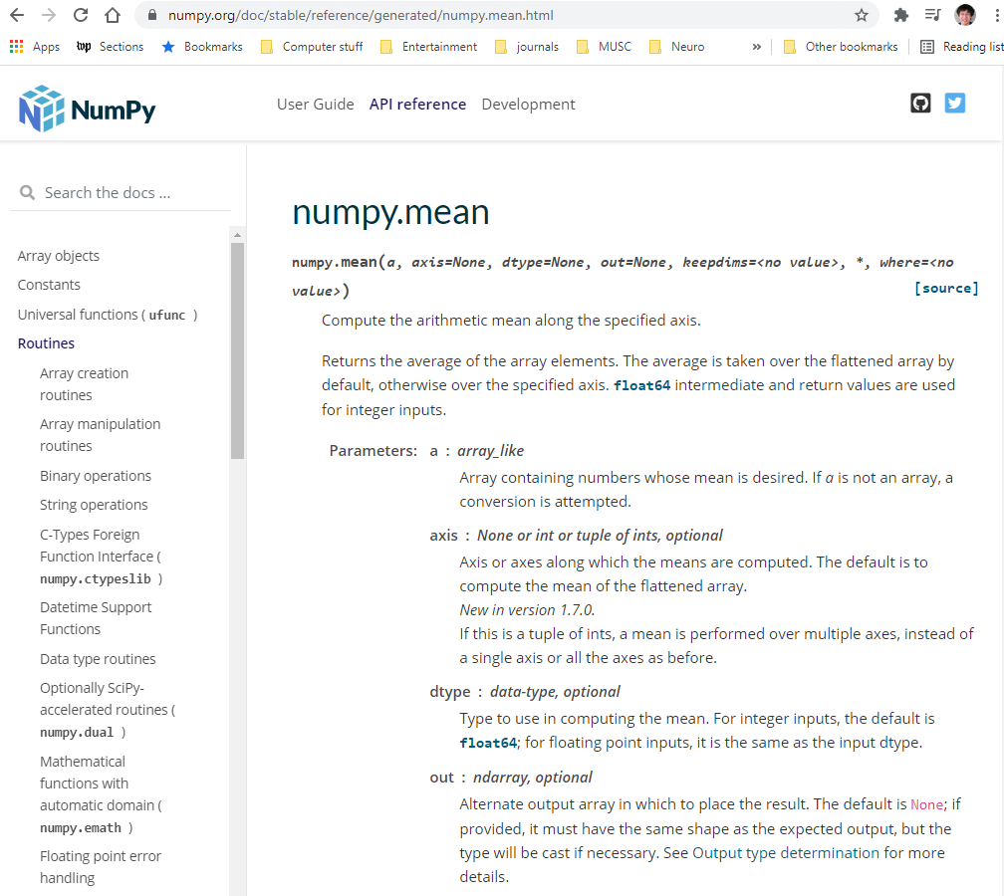
A few notes about Python functions:
Package name
Function name

Slide 60
Arguments are distinguished by their position (1st, 2nd, 3rd) or name:
First argument (no name)
2nd argument (named)
3rd argument (named)

Slide 61
Named arguments can be in any order:
np.mean(calcium, axis = 0, dtype = np.float32)
np.mean(calcium, dtype = np.float32, axis = 0)

Slide 62
Skipped arguments take default value:
Default values if skipped

Slide 63
Another common way to call functions:
np.mean(calcium, axis = 0)
# The following is functionally equivalent:
calcium.mean(axis=0)
This works because of something called “object oriented programming”.

Slide 64
Think of “objects” as “smart” variables:

Slide 65
The code:
% Generate/plot 5 Hz square wave
t = np.arange(100)/100
y = scipy.signal.square(t*5*2*pi);
np.step(t, y)
% Calculate/plot FFT
f = np.fft.fft(y);
np.plot(abs(f))
waveform
FFT
Notes:
The function is easy to call, but you have to pay careful attention to the details of the frequencies that come out.

Slide 66
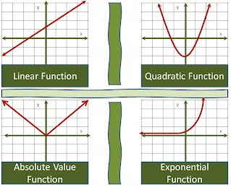
Convolution, FFT, are all “linear” functions

Slide 67
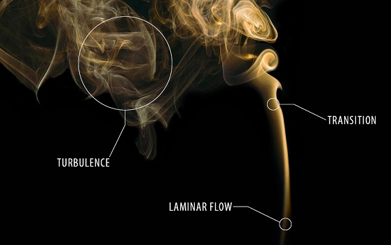
Much of nature is non-linear
But non-linear math is freakishly complex, so we try to make linear approximations wherever possible.
Many things are linear, up to a point.

Slide 68
Algebraic definition of linearity:
All terms square and higher are zero:
$$f\left(x\right)=a+bx+cx^{2}+dx^{3}+gx^{4}+{hx}^{5}+…$$

Slide 69
Most general definition of linearity
A function f is linear if and only if:
f(x + y) = f(x) + f(y) f (of sums) = sum (of f’s)
af(x) = f(ax) Scalability
Notes:
If you want to convolve A with the sum of B and C, you can break it into two easier tasks. First convolve A with B, then A with C, then add the two results.
All linear functions are handy this way, they can always be broken down into parts, solved independently, then added back together.

Slide 70
Good overview of filtering:
https://www.sciencedirect.com/science/article/pii/S0896627319301746

Slide 71
Why “abs”?
% Calculate/plot FFT
f = fft(y);
plot(abs(f))
FFT
Notes:
The function is easy to call, but you have to pay careful attention to the details of the frequencies that come out.

